Slide 1
JEPA
(Joint Embedding Predictive Architecture)
Rebekah Xing
Datasci224 Final Presentation
Notes:
Hi everyone. Today I will be presenting JEPA, which stands for Joint Embedding Predictive Architecture.

Slide 2
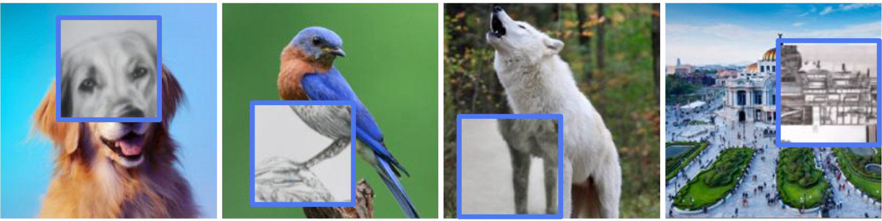
What is JEPA?
Self-supervising learning of semantic world representations
It learns by using the visible context of an input to predict the embedding/representation of a hidden target part
JEPA does not reconstruct pixels; it predicts higher-level meaning
Notes:
JEPA is a self-supervised learning method for learning semantic world representations. By semantic world representations, what that means is features that capture the meaning and structure of what the model sees, not just surface-level details like brightness, texture, or individual pixels.
Self-supervised means the model learns from the data itself, instead of needing a human label for every example during pretraining. The main idea is that JEPA uses the visible context of an input to predict the embedding, or representation, of a hidden target part.
The important detail is that JEPA does not reconstruct pixels. For example, if JEPA sees the left side of a dog, it should learn that the hidden part is probably related to the rest of a dog, not random pixels. It does not need to draw the exact fur pixel by pixel, instead it needs to understand the object-level structure.

Slide 3
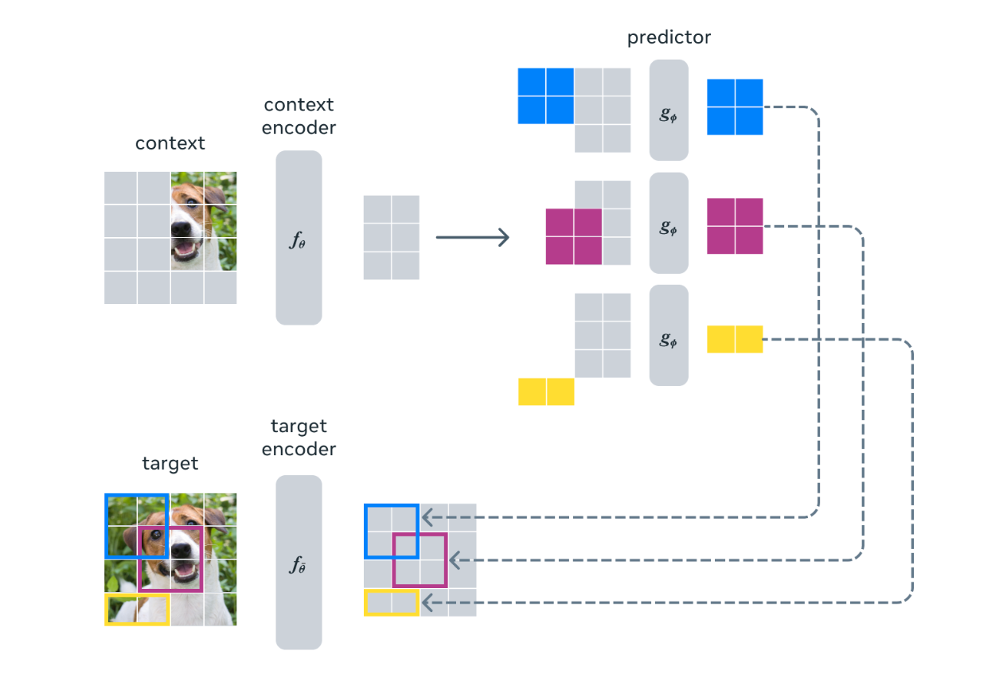
How does it work?
Image is split into visible context and hidden target regions
Context Encoder: converts the visible context region into context embeddings
Predictor: predicts target embeddings using the context embeddings
Target Encoder: generates target embeddings from the hidden target region
Notes:
So, how does JEPA work? From the figure, we see the context of an image of half of a dog’s face. The context encoder takes the visible patches of this image and turns them into a context embedding, which summarizes what the model can see.
Next, the predictor uses the context embedding to guess the embeddings of the hidden target regions, shown in blue, purple, and yellow.
For the target, we are given the whole image of the dog. The target encoder looks at the actual hidden regions and produces the correct target embeddings, which in this case, is the blue, purple, and yellow regions that the predictor had just created context embeddings for. During training, the model compares the predicted embeddings to the actual target embeddings. Over time, it learns to make better predictions.
This is how the algorithm learns to use visible information to predict the representation of missing information.

Slide 4

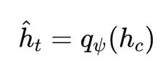
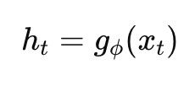

Math Behind JEPA
Context Embedding:
Predictor:
Target Embedding:
Loss Comparison:
→ the context encoder takes in the visible part of the image and turns it into an embedding
→ predictor uses the context embedding to guess the hidden target embedding
→ the target encoder turns the actual hidden part into the true target embedding
→ penalizes the model when the predicted embedding is far from the true target embedding
Notes:
Now I’ll go through the math behind JEPA. First, the input image is split into two parts. I’ll call the visible context x_c, and the hidden target x_t. The context is what the model gets to see. The target is what the model is trying to predict.
The first step is the context embedding:
h_c = f_theta(x_c).
Here, f_theta is the context encoder. It is a neural network, and theta represents the parameters it learns during training. It takes the visible context x_c and turns it into h_c, a vector summary of what the model can see.
Next is the predictor:
h_hat_t = q_psi(h_c).
Here, q_psi is another learnable function. It takes the context embedding and predicts what the hidden target embedding should be. The hat over h_t means this is the model’s guess.
Then we need the actual target embedding:
h_t = g_phi(x_t).
Here, g_phi is the target encoder. It looks at the real hidden target region x_t and creates the true target embedding h_t. You can think of this as the answer key during training.
Finally, JEPA compares the prediction to the answer key:
L_JEPA = || h_hat_t - h_t ||^2.
The double bars notation means we calculate the distance between the two embeddings, and the squared term penalizes larger mistakes more strongly.
So the math is doing one thing over and over: look at the visible part, predict the hidden part’s embedding, compare that prediction to the true hidden embedding, and update the learnable parameters to make the next prediction better.

Slide 5
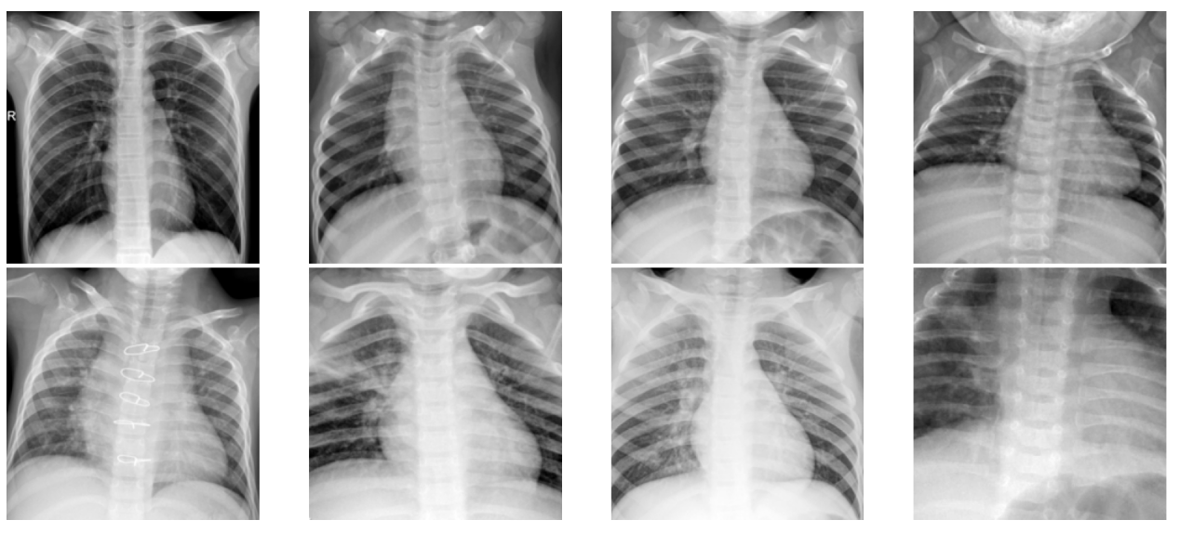
JEPA on Pneumonia X-Rays
Dataset: PneumoniaMNIST
Pediatric chest X-rays
Binary task: Normal vs. Pneumonia
Research Question:
Can JEPA-style self-supervised pre-training improve label efficiency for pneumonia classification?
Goal:
Test whether self-supervised pretraining reduces the labeled data needed
Notes:
Now, for my project, the dataset I used is PneumoniaMNIST. It contains pediatric chest X-rays and is set up as a binary classification task: normal versus pneumonia.
Each input is a chest X-ray image. The output is the probability that the image belongs to the pneumonia class. My research question is:
Can JEPA-style self-supervised pretraining improve label efficiency for pneumonia classification?
In simpler terms, if I only have a small number of pneumonia labels, can JEPA help the model learn better than starting from scratch?
This dataset is a good fit for JEPA because chest X-rays have strong structure. The visible parts of an X-ray can give information about hidden parts, especially because anatomy is spatially organized.
The goal is to test whether self-supervised pretraining reduces the amount of labeled data needed for good classification.

Slide 6
Thank You!
12 March 2030

